Slide 1
Palm Sunday Sunday, 5 April 2020
United together on Palm Sunday
How can we publicly acknowledge this important day on our calendar when so many of us will be behind closed doors? This Sunday (April 5th) we invite all families to put a branch on their front door or on the window, to celebrate Palm Sunday.
It could be any green branch you have in your garden. This would help, despite the social distancing, to be connected as we enter into the Holiest of Weeks.
We may be physically isolated, but not separated. We are united as the body of Christ.
We are the Church. Lets Share this gesture with our family and friends to spread Faith and Hope.
Email pictures to Ms Rizzo caterina.rizzo@syd.catholic.edu.au

Slide 2
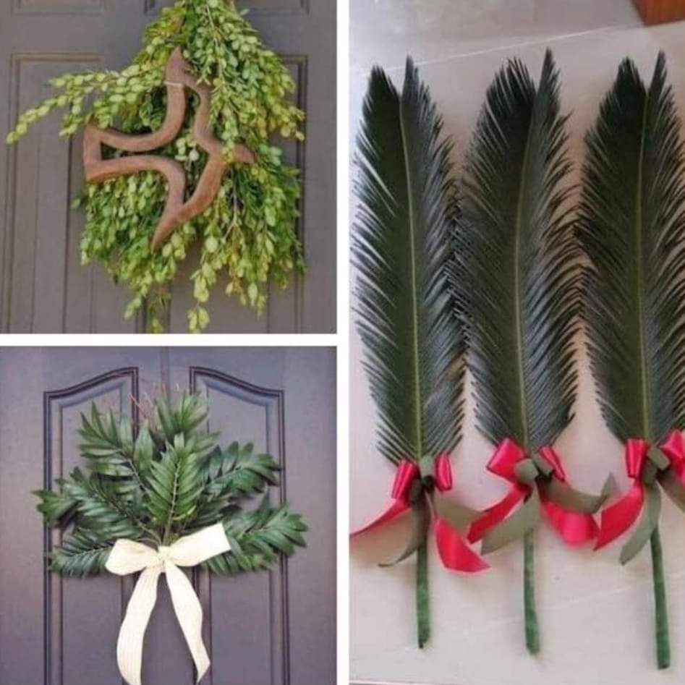
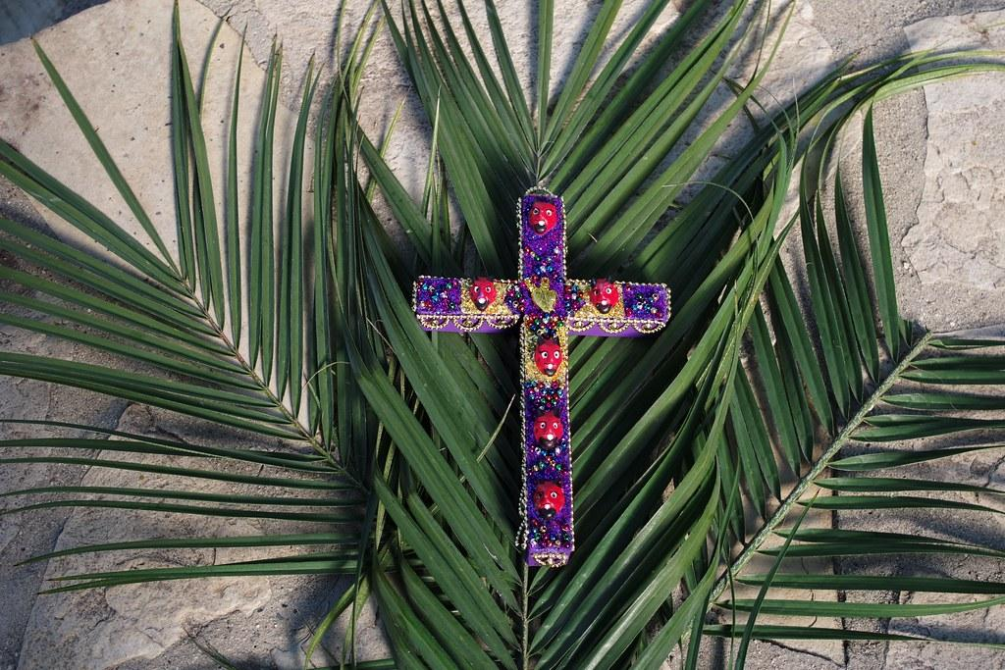
Email your photo to Ms Rizzo caterina.rizzo@syd.catholic.edu.au

